Slide 1
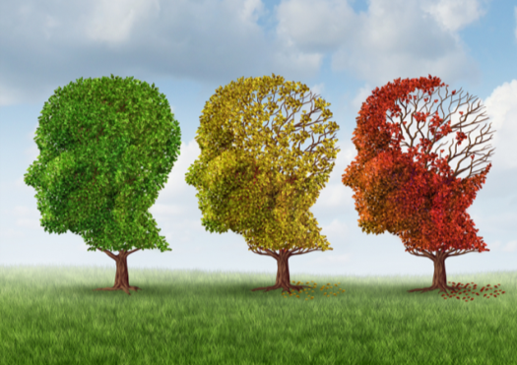
Dementia and Alzheimer’s Disease: The Basics
Developed by:
University of Wisconsin Oshkosh
Center for Community Development, Engagement and Training (CCDET)
Wisconsin Department of Health Services
Division of Quality Assurance (DQA)
www.uwosh.edu/caregiver
September 2018

Slide 2
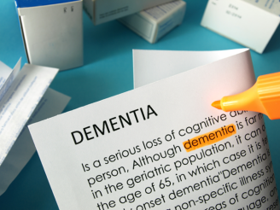
Introduction
Review the Learning Points
Caring for Residents with Cognitive Disorders
Activity: Thinking about Dementia

Slide 3
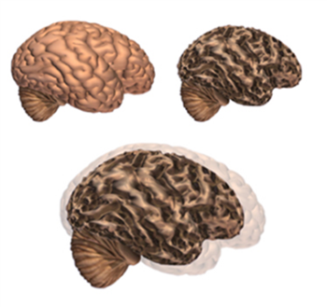
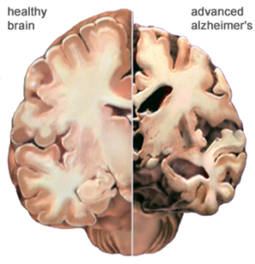
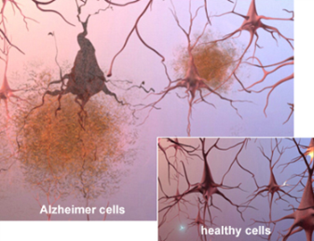
What is Dementia?
Dementia
general term that describes a group of symptoms
Alzheimer’s Disease
the most common type of dementia
©2018 Alzheimer's Association. www.alz.org. All rights reserved. Illustrations by Stacy Jannis.

Slide 4
Alzheimer’s Disease: A Video Tour of the Brain
What is Dementia?
www.aboutalz.org

Slide 5
Other Types of Dementia
MCI
Vascular Dementia
Dementia with Lewy Bodies
Mixed Dementia

Slide 6
Behavioral Symptoms of Dementia
Mild Changes
Moderate Changes
Severe Changes

Slide 7
Activity: Recognizing Behavioral Symptoms
Lara Jacobs
Joseph Lewis
Isabel Johns

Slide 8
Other Conditions That Affect Behavior
Delirium
Usually causes abrupt changes
May be caused by infection, medication, etc.
Most common cause: urinary tract infections
Depression
Affects mood; symptoms include sadness/loss of interest
At least five symptoms must be present for diagnosis

Slide 9
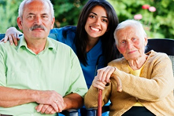
Managing Behavioral Symptoms
Changes can produce challenges
Agitation, aggression, hallucinations, wandering, etc.
Person-centered approaches can help calm residents
Think of some approaches to help calm a resident in distress

Slide 10
Risk Factors
Age, family history, genetics
Lifestyle risk factors
Alcohol abuse
Smoking
Diabetes
Head injuries
Heart disease
Remember:
What’s good for your heart  is good for your brain!

Slide 11
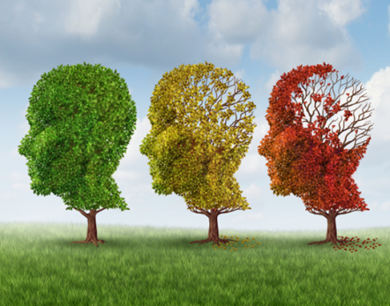
Workshop Closing
Wisconsin Facts & Figures
Wrap-Up: Changes aren’t something residents can control…and behaviors aren’t purposely directed at you
Review Learning Points
For additional training opportunities: www.uwosh.edu/caregiver
or email caregiver@uwosh.edu

